Slide 1
Automated unified system for LPG
By
GOKULA KAVEEYA S.
GOMATHI S.
KAVIPRIYA K.
PROJECT GUIDE-KALAISELVI A.
BATCH NO 9

Slide 2
Abstract
Gas leakage is a major problem with industrial sector, residential premises etc. One of the preventive methods to stop accident associated with the gas leakage is to install a gas leakage detection kit at vulnerable places. The aim of this project is to present such a design that can automatically detect, alert gas leakage and measure the amount of the gas present in the cylinder and intimate the user when the gas level goes low by using Raspberry pi

Slide 3
Existing system
Booking is the little time consuming process and it requires some knowledge about the messaging and internet, its difficult task for the Uneducated people and time consuming for busy schedule people. And users will not be able to guess the level of the gas. So booking was not within time.
The system also involves in measuring the amount of gas and detecting whether there is any leakage in the gas, alerts the user through SMS with the use of microcontroller and sensors.

Slide 4
Proposed system
LPG gas leakage detection is done with the use of sensor ,Raspberry pi as controller and also the detection of weight in a regular basis and intimating the user about the status of amount of the gas.
This system aims at integrating the leakage detection and amount of gas detection in cost efficient manner.

Slide 5
Advantages
This system has the major advantage of alerting the user, if any leakage is detected as well as the status of the amount of gas whether the level of gas is low.
Cost efficient
Supports additional module for measuring the amount of gas.

Slide 6
Hardware requirements
Raspberry pi
Audriono UNO
GSM
Breadboard
Sensor-MQ5( LPG sensor)
Load cell
Wifi dongle
LEDs

Slide 7
Software Requirements
Software : Arduino 1.6.7
Database : My sql

Slide 8
Architechtural diagram
Overview of the system
MQ5
Raspberry pi
GSM
LOAD CELL
USER
SERVER

Slide 9
Modules
Gas leakage detection
Notifications to the user.
Verification for Gas refill
Auto gas booking

Slide 10
Gas Leakage detection
The leakage of gas is detected through the leakage sensor (MQ5) and the alert is sent to the users mobile number this system provides the home security. The Raspberry pi kit is used as the controller connected to the Sensor which detects about the leakage of the gas through specific units(ppm)

Slide 11
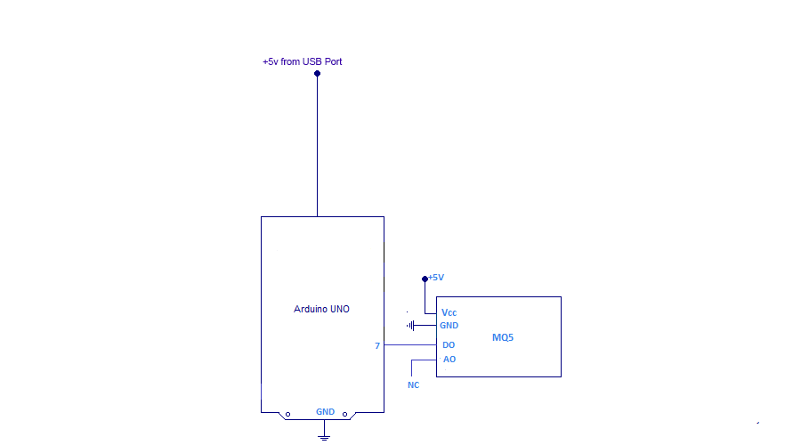
Block diagram for module 1

